Slide 1
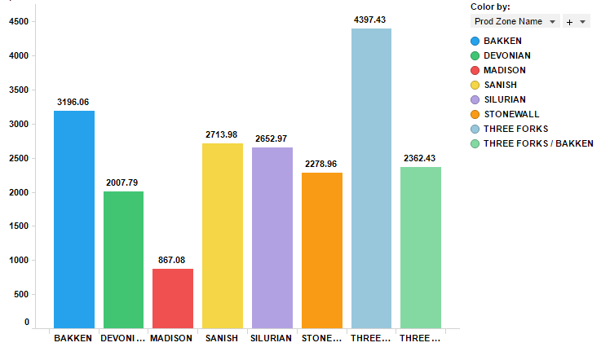
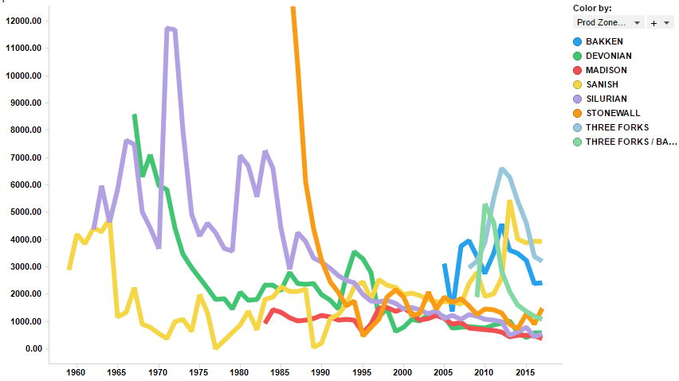
Overview of Data
The dataset contains 47,290 row with 53 columns
Bar Chart of Liquid Vs Prod Zone
Production Volume by Year
Avg(Liquid)
Avg(Liquid)
Prod Zone
Year

Slide 2
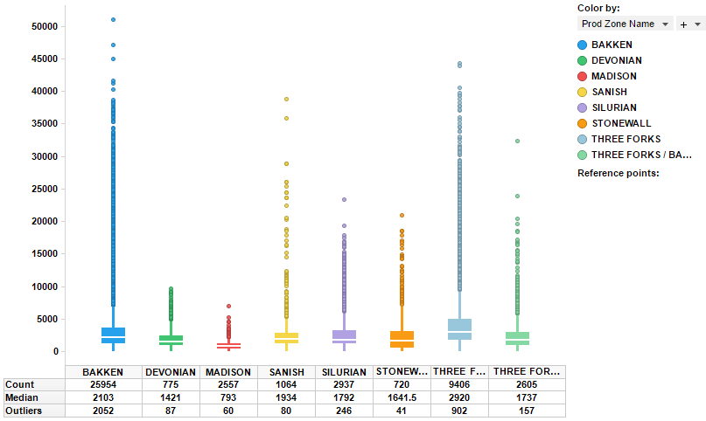
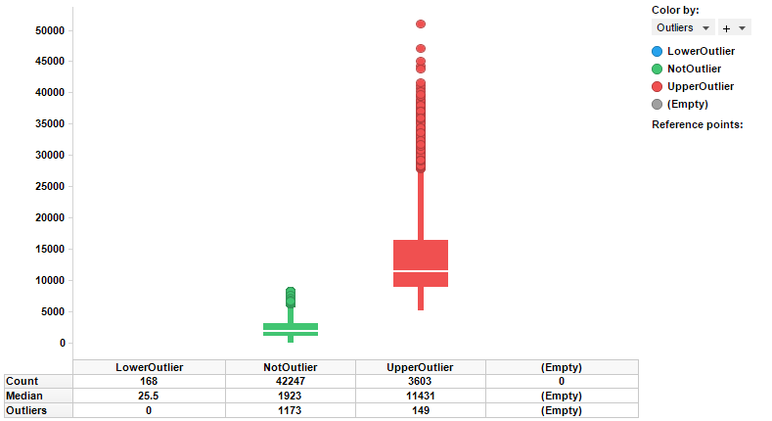
Overview of Data
The dataset contains 47,290 row with 53 columns
Identifying outliers
Box Plot of Liquid Vs Prod Zone
Detecting outliers
Avg(Liquid)
Liquid
Outliers
Prod Zone
The right plot shows the production volume by the number of available outliers based on upper, lower or no outliers.
The left plot shows the production volume by production zone and identify the median and outliers by area.

Slide 3
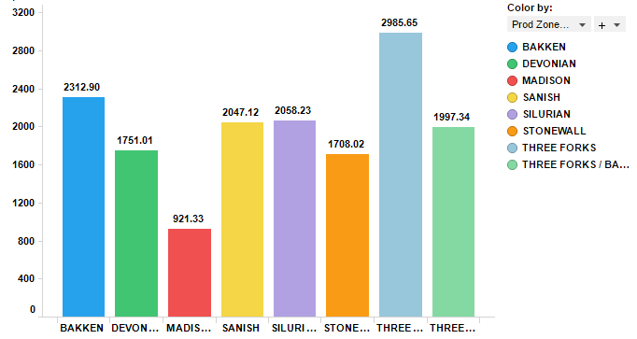
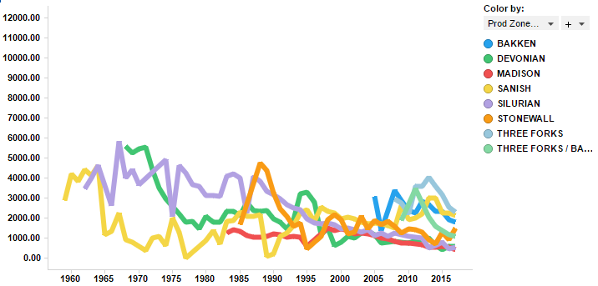
Effect of Outlier on Dataset
Outliers in data can distort predictions and affect the accuracy, if you don’t detect and handle them appropriately especially in regression models.
Why outliers treatment is important?
Because, it can drastically bias/change the fit estimates and predictions. Let me illustrate this using the cars dataset.
To better understand the implications of outliers better, I am going to compare the fit of a simple linear regression model on cars dataset with and without outliers. In order to distinguish the effect clearly, I manually introduce extreme values to the original cars dataset. Then, I predict on both the datasets.
Univariate approach For a given continuous variable, outliers are those observations that lie outside 1.5 * IQR, where IQR, the ‘Inter Quartile Range’ is the difference between 75th and 25th quartiles. Look at the points outside the whiskers in below box plot.
After Outlier treatment
Bar Chart of Liquid Vs Prod Zone
Production Volume by Year
Avg(Liquid)
Avg(Liquid)
Prod Zone
Year

Slide 4
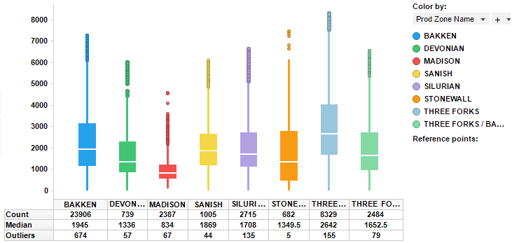
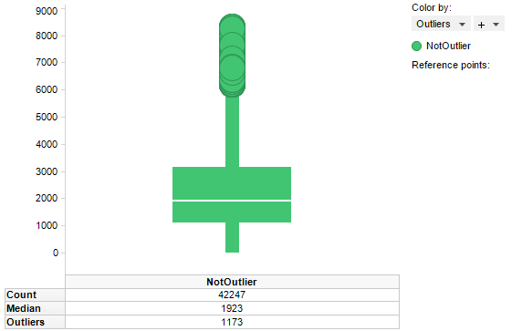
After Outlier treatment

